Slide 1


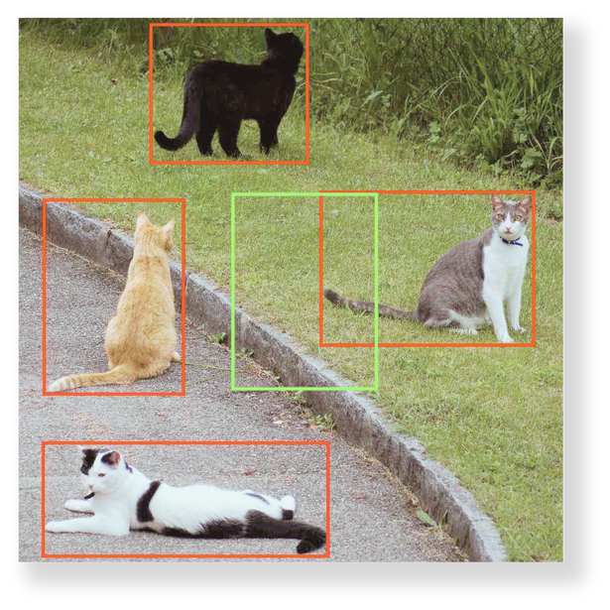
ROI Pooling
ll
When is it used, it is importance and other similar methods to it.
Introduction to ROI Pooling in Object Detection
Definition
Usage
ROI Pooling
Projection
Quantization
Other Similar Methods
ROI Align, ROI Warp, Spatial Pyramid Pooling (SPP)
Atanda Abdullahi Adewale, 2024

Slide 2
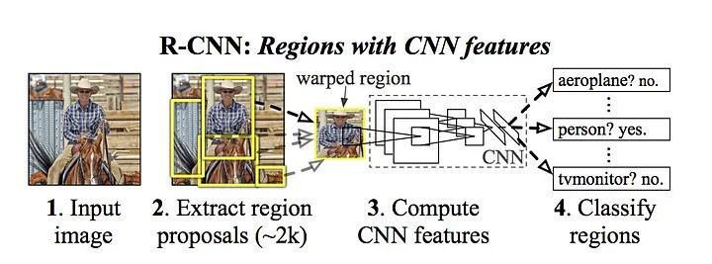
Introduction : ROI Pooling
Definition and Usage
RCNN
Region proposal (2k) using selective search
Greedy NMS, 4096 dim SVM, Begressor
Slow. Not real-time
Notes:
I want to explain how to extract Region of Interest (ROI) via pooling aka ROI pooling
lets Recall :
RCNN introduces Region proposal (2k) pipleline

Slide 3
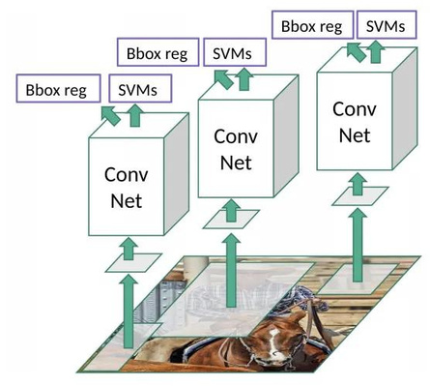
Introduction : ROI Pooling
Definition and Usage
RCNN
Region proposal (2k) using selective search
Greedy NMS, 4096 dim SVM, Begressor
Slow. Not real-time

Slide 4
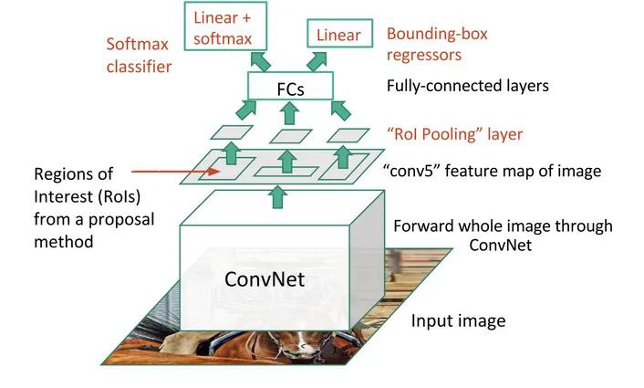
Introduction : ROI Pooling
Definition and Usage
RCNN
Region proposal (2k) using selective search
Greedy NMS, 4096 dim SVM, Begressor
Slow. Not real-time
Fast and Faster RCNN
ROI from image Feature map
ROI pooling (fixed size) for CNN
Notes:
Let’s recall that Fast RCNN introduces ROI pooling
- Pass image to backbone network (e.g. ResNet or VGG).
- Extract feature map (
- Pass feature map to EXTERNAL Region Proposal ALGORITHM (Selective Search).
- obtain take Region of Interest (ROI) and return fixed size feature map via pooling or align operations.
- Pass fixed size feature map from ROI pooling (or align) into R-CNN to get bounding box predictions and class scores.
- Pass fixed size feature map from ROI pooling (or align) into CNN to get segmentation mask.

Slide 5
Introduction : ROI Pooling
Definition and Usage
RCNN
Region proposal (2k) using selective search
Greedy NMS, 4096 dim SVM, Begressor
Slow. Not real-time
Fast and Faster RCNN
ROI from image Feature map
ROI pooling (fixed size) for CNN
ROI Pooling
A process that extracts a fixed-size feature map (e.g., 7x7) from each region proposal, regardless of its size and performing max pooling in each.
Notes:
In object detection, each proposal will be of a different shape. So there is a need for converting all the proposals to fixed shape as required by fully connected layers

Slide 6
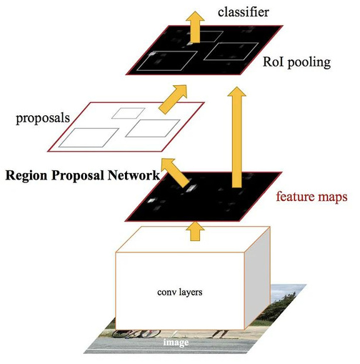
Introduction : ROI Pooling
Definition and Usage
RCNN
Region proposal (2k) using selective search
Greedy NMS, 4096 dim SVM, Begressor
Slow. Not real-time
Fast and Faster RCNN
ROI from image Feature map
ROI pooling (fixed size) for CNN
ROI Pooling
A process that extracts a fixed-size feature map (e.g., 7x7) from each region proposal, regardless of its size and performing max pooling in each.
Notes:
Faster R-CNN builds upon Fast R-CNN by adding a Region Proposal Network, which allows for the generation of region proposals directly within the network,
Each proposal has five values, the [index Xmin, Ymin, x max and Y max
Generally, it represents the top-left and bottom-right corner of the proposal.

Slide 7
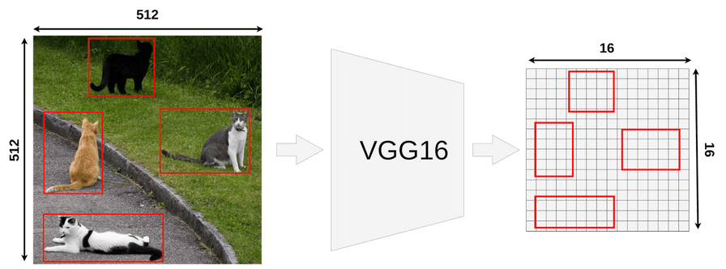
ROI Pooling
Definition and Usage
ROI is not a Bounding Box
Every RoI has it’s original coordinates and size
Map ROI onto Feature Map
[1, 3, 512, 512]
[1, 512, 16, 16]

Slide 8
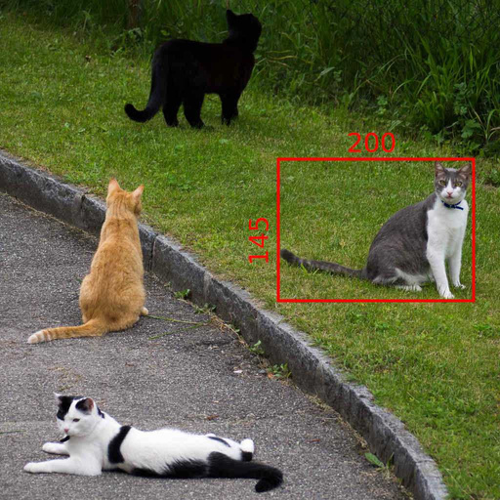
ROI Pooling
Definition and Usage
ROI is not a Bounding Box
Every RoI has it’s original coordinates and size
Map ROI onto Feature Map
[1, 3, 512, 512]
[1, 512, 16, 16]

Slide 9
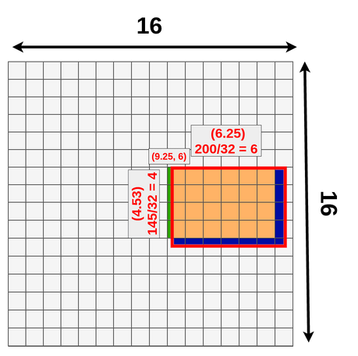
ROI Pooling
Definition and Usage
ROI is not a Bounding Box
Every RoI has it’s original coordinates and size
Map ROI onto Feature Map
[1, 3, 512, 512]
[1, 512, 16, 16]
Width: 200/32 = 6.25 Top x: 296/32 = 9.25
Height: 145/32 = ~4.53 Top y: 192/32 = 6
4x6x512
3x3x512

Slide 10
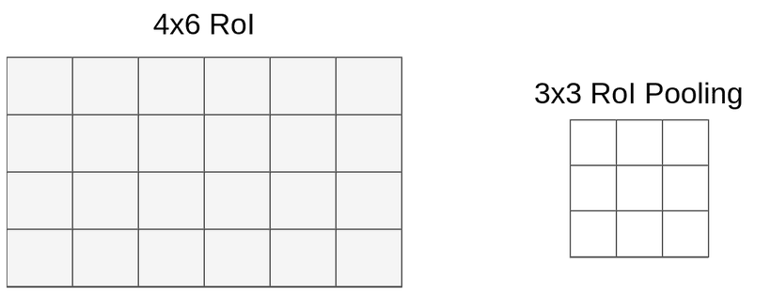
ROI Pooling
Definition and Usage
ROI is not a Bounding Box
Every RoI has it’s original coordinates and size
Map ROI onto Feature Map
[1, 3, 512, 512]
[1, 512, 16, 16]
Width: 200/32 = 6.25 Top x: 296/32 = 9.25
Height: 145/32 = ~4.53 Top y: 192/32 = 6
4x6x512
3x3x512

Slide 11
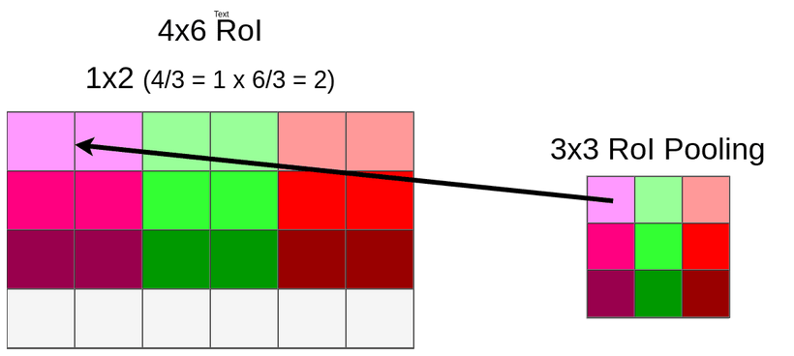
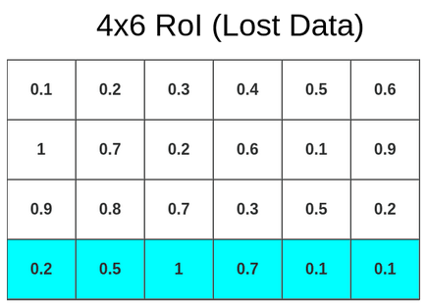
ROI Pooling
Definition and Usage
ROI Quantization

Slide 12
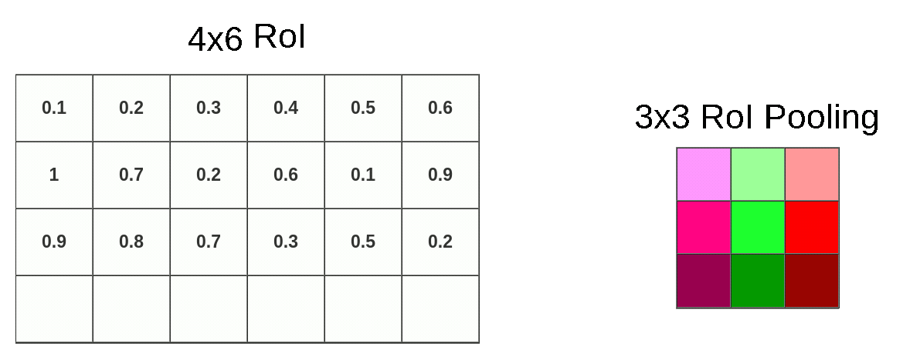
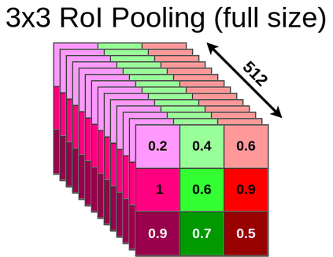
ROI Pooling
Definition and Usage
ROI Quantization
ROI Pooling

Slide 13
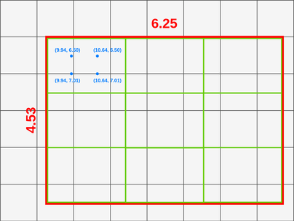
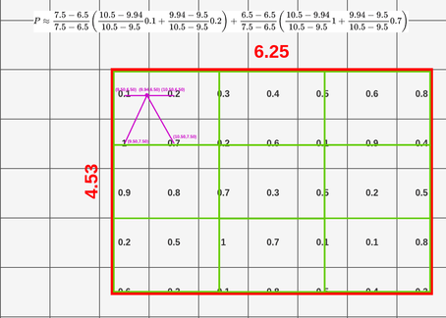
Other methods
RoIAlign gives us better precision on average.
ROI Align

Slide 14
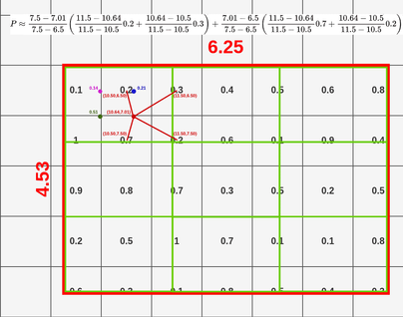
Other methods
RoIAlign gives us better precision on average.
ROI Align
ROI Align Linear
Interpolation

Slide 15
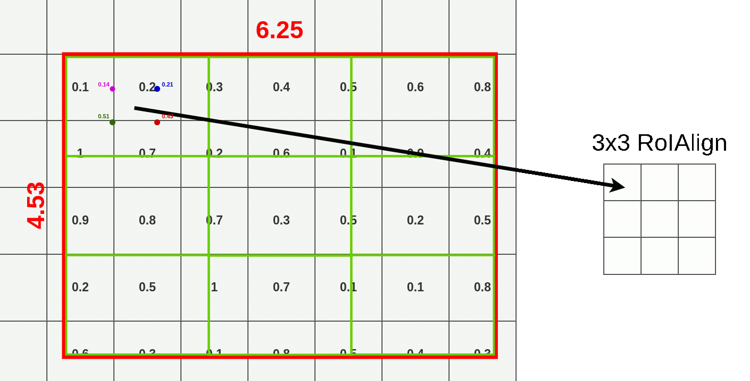
Other methods
RoIAlign gives us better precision on average.
ROI Align
ROI Align Linear
Interpolation

Slide 16
Other methods
RoIAlign gives us better precision on average.
ROI Align
ROI Align Linear
Interpolation
ROI Warp
Spatial Pyramid Pooling (SPP)
Adaptive Pooling

Slide 17
Appendix
References:
"Fast R-CNN" by Ross Girshick (2015) - This paper introduces ROI pooling in the context of Fast R-CNN for object detection.
"Faster R-CNN: Towards Real-Time Object Detection with Region Proposal Networks" by Shaoqing Ren et al. (2015) - This paper presents the Faster R-CNN framework, which popularized the use of ROI pooling in object detection.
"Mask R-CNN" by Kaiming He et al. (2017) - This paper extends Faster R-CNN with a mask prediction branch and provides insights into the use of ROI pooling for both bounding box regression and mask prediction.
J. Dai, K. He, and J. Sun. Instance-aware semantic segmentation via multi-task network cascades. In CVPR, 2016 “Instance-aware Semantic Segmentation via Multi-task Network Cascades” (2015) - Jifeng Dai
"Understanding Region of Interest —Kemal Erdem ML Developer, Software Architect, JS Engineer, Ultra-distance cyclist Published 6 Feb 2020 https://erdem.pl/2020/02/understanding-region-of-interest-ro-i-pooling.
ROI pooling vs. ROI align, Firiuza, Jan 8, 2020 https://firiuza.medium.com/roi-pooling-vs-roi-align-65293ab741db

Slide 18
Thank You

